Slide 1
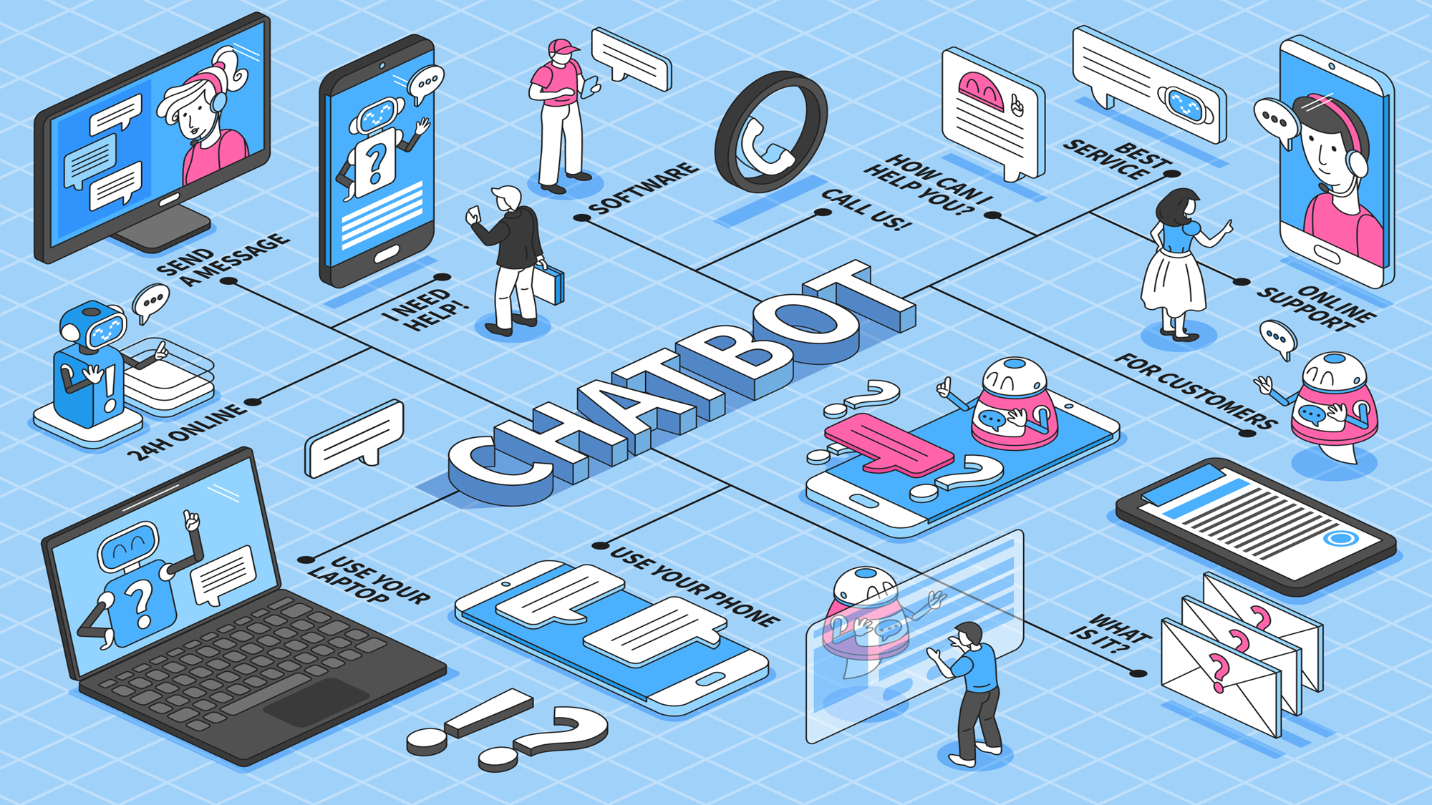
An AI-powered system for patient monitoring and chat bot

Slide 2
Uses of first aid chat bot
1.Emergency response: In case of an emergency, a first aid chat bot can provide immediate assistance to those who need it. The chat bot can give instructions on how to perform CPR or other life-saving techniques.
2.Education: A first aid chat bot can provide users with information about common injuries and how to treat them. It can also offer guidance on how to prevent injuries and illnesses.
3.Accessibility: A first aid chat bot can be accessed from anywhere, at any time. This means that people who need first aid assistance can get it even if they are in a remote area or don't have access to medical professionals.
4.Peace of mind: Knowing that a first aid chat bot is available can provide peace of mind to people who are concerned about their health or the health of their loved ones.
5.First aid training: A first aid chat bot can be used as a tool for training people in basic first aid techniques. It can provide step-by-step instructions and quiz users to ensure they understand the material.

Slide 3
Use of first-aid chat bot to the public
1.Accessible First Aid Assistance: A first-aid chat bot can provide immediate assistance to people in need of first-aid help. It can offer step-by-step instructions on how to perform basic first-aid techniques such as CPR, treating burns, and stopping bleeding, among others.
2.Quick Responses: A first-aid chat bot can provide quick responses to queries and concerns about first aid. Users can easily type in their question or concern, and the chat bot will provide a prompt response.
3.24/7 Availability: A first-aid chat bot is available 24/7, so people can get help whenever they need it. It can be particularly helpful in emergencies when medical professionals are not immediately available.
.

Slide 4
4.Learning Tool: A first-aid chat bot can be used as a learning tool to educate the public on basic first-aid techniques. It can provide users with valuable information on how to prevent injuries, recognize medical emergencies, and provide basic first-aid care.
5.Peace of Mind: A first-aid chat bot can provide peace of mind to people who are concerned about their health or the health of their loved ones. Knowing that a reliable first-aid chat bot is available can reduce anxiety and stress levels in case of a medical emergency

Slide 5
Implementation of first-aid chat bot
This bot is implemented in WhatsApp ,web, etc…….in social media .We prefer it in WhatsApp because in WhatsApp we can use video call or in voice call to use or in text . it will show the steps and procedures in text or voice message and it will show some demonstration videos and it will refer some doctors and near by hospitals and it will show what food the patient want to take and we can fix the appointment to the doctor’s

Slide 6
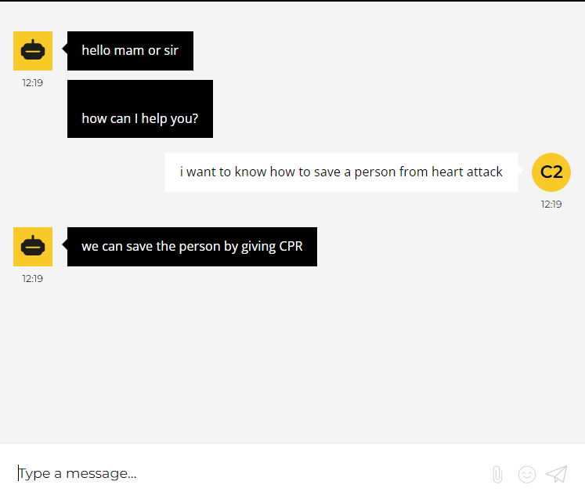
Demo working of chat bot

Slide 7
Adult Basic and Advanced Life Support
Basic Life Support (BLS) and Advanced Life Support (ALS) are two levels of emergency medical care provided to individuals who are experiencing cardiac arrest or other life-threatening medical emergencies.
Basic Life Support (BLS) includes the skills necessary to sustain life in the initial moments of cardiac arrest or other medical emergencies. These skills include recognizing signs of cardiac arrest, performing chest compressions, administering oxygen and airway management, and defibrillation (use of automated external defibrillator or AED).
Advanced Life Support (ALS) builds upon BLS and includes additional medical interventions such as intravenous (IV) drug therapy, advanced airway management, and electrocardiogram (ECG) monitoring. ALS is provided by healthcare professionals such as paramedics, emergency medical technicians (EMTs), and nurses.
Both BLS and ALS are important in the management of life-threatening medical emergencies. Early recognition and appropriate interventions are critical to improving patient outcomes.

Slide 9
WHAT IS CPR ?
CPR stands for cardiopulmonary resuscitation, which is a life-saving technique used to help revive a person who has stopped breathing or whose heart has stopped beating. CPR involves a combination of chest compressions and rescue breaths to help keep oxygen flowing to the person's brain and other vital organs until medical help arrives. The goal of CPR is to maintain blood flow and oxygenation to the body's organs until the person can be treated by a medical professional. CPR is a critical skill that can help save lives in emergency situations.

Slide 10
Types of cpr
Basic Life Support (BLS) CPR: This is the most commonly taught form of CPR and is designed for use by anyone, regardless of their medical training. BLS CPR involves performing chest compressions and rescue breaths to maintain blood flow and oxygenation to the person's body until medical help arrives.
Advanced Cardiac Life Support (ACLS) CPR: This type of CPR is designed for use by medical professionals, such as doctors and nurses. ACLS CPR involves more advanced techniques, such as the use of medications and specialized equipment, to help revive a person who has suffered a cardiac arrest.
Pediatric CPR: Pediatric CPR is similar to BLS CPR but is specifically designed for use on infants and young children. It involves performing chest compressions and rescue breaths at a faster rate than in adult CPR and requires special attention to the child's airway and breathing.

Slide 12
What is Lay Responders ?
Lay responders are individuals who are not medical professionals but have been trained in basic life support (BLS) techniques such as CPR (cardiopulmonary resuscitation) and first aid. Lay responders can include members of the general public, including family members, friends, and co-workers, as well as individuals who work in non-medical fields such as teachers, coaches, and security personnel.
Lay responder training in CPR typically involves learning the basic steps of BLS CPR, including how to perform chest compressions and rescue breaths, as well as how to use an automated external defibrillator (AED) if one is available.

Slide 13
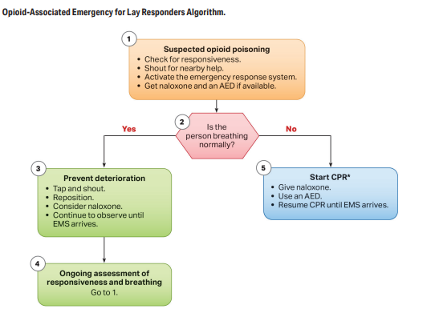
Lay responders play a crucial role in emergency situations, as they are often the first people to respond to a medical emergency before professional medical help arrives. By providing immediate CPR and first aid, lay responders can help increase a person's chances of survival and minimize the risk of long-term complications.

Slide 14
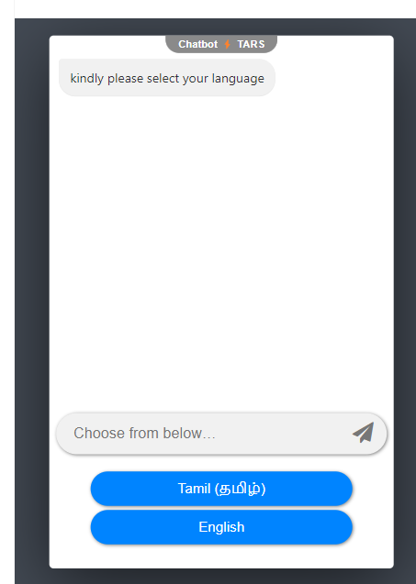
Working mode of chat bot

Slide 15
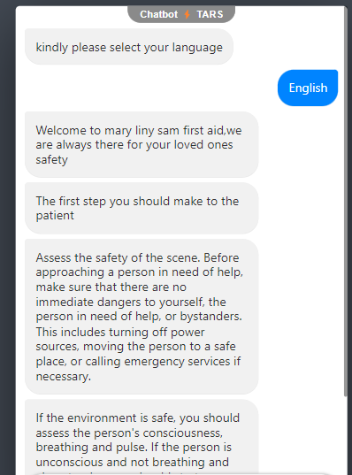

Slide 16
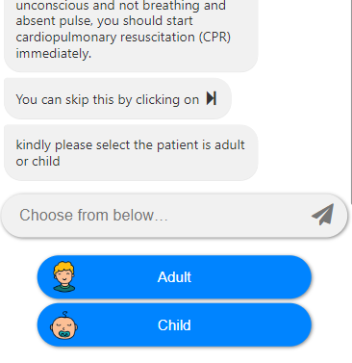

Slide 17
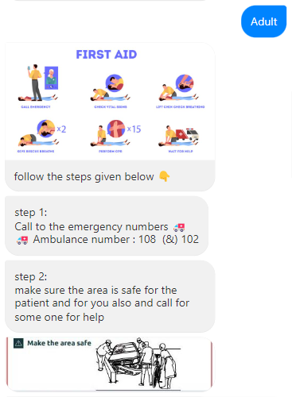

Slide 18
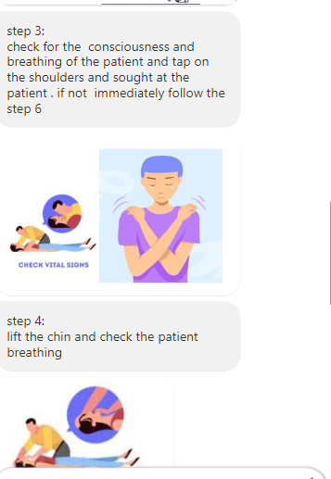

Slide 19
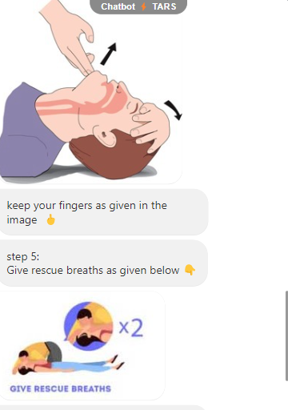

Slide 20
